Slide 2
Hasta el beacon, todo es bluetooth
Gorka Madariaga
Technical Evangelist, .NET developer
@Gk_8

Slide 4
Agenda
Beacons
What’s that?
Protocols: iBeacon & Eddystone
UWP libraries
Foreground watcher
Foreground advertiser
Working from the background
Community libraries
Xamarin components
Demos – usage examples

Slide 5

Gorka Madariaga
Proud basketball coach of 14 girls…
…and pseudo-player
Trips to USA organizer (NBA&NFL)
Did I mention that I also do some development?

Slide 6
Beacons overview

Slide 7
What is a beacon?
Small ARM computer,
with a Bluetooth Smart connectivity module,
powered by a battery

Slide 8
What is a beacon?
You can think about the beacon as a small lighthouse
But instead of light, it uses radio waves…and instead of ships, it alerts devices of its presence and info

Slide 9
Protocols

Slide 10
Beacons broadcast tiny packets of data, containing their unique ID and information about signal strength and other parameters

Slide 11
iBeacon
Every iBeacon ID is 20 bytes long and is divided into three sections:
- UUID (16 bytes)
- major number (2 bytes)
- minor number (2 bytes)
Store location |  | New York | Los Angeles | San Francisco
UUID |  | DDD468A7-056B-9E2F-EAE2-6FCE4706331E
Major |  | 1 | 2 | 3
Minor | Clothing | 10 | 10 | 10
 | Housewares | 20 | 20 | 20
 | Automotive | 30 | 30 | 30

Slide 12
Proximity beacon advertising package

Slide 13
Eddystone
Every Eddystone data frame contains the Frame Type information on its first byte:
Frame Type | High-Order 4 bits | Byte Value
UID | 0000 | 0x00
URL | 0001 | 0x10
TLM | 0010 | 0x20
RESERVED | 0011 | 0x30
RESERVED | 0100 | 0x40

Slide 14
Eddystone-UID
The Eddystone-UID frame broadcasts an opaque, unique 16-byte Beacon ID composed of:
10-byte namespace
6-byte instance
Store location |  | New York | Los Angeles | San Francisco
Namespace |  | DDD468A7-056B-9E2F-EAE2-6FCE4706331E
Instance | Clothing | 000000000110 | 000000000210 | 000000000310
 | Housewares | 000000000120 | 000000000220 | 000000000320
 | Automotive | 000000000130 | 000000000230 | 000000000330
Notes:
The namespace portion of the ID may be used to group a particular set of beacons, while the instance portion of the ID identifies individual devices in the group

Slide 15
Eddystone-URL
The Eddystone-URL frame broadcasts a URL using a compressed encoding format in order to fit more within the limited advertisement packet
Byte offset | Field | Description
0 | Frame Type | Value = 0x10
1 | TX Power | Calibrated Tx power at 0 m
2 | URL Scheme | Encoded Scheme Prefix
3+ | Encoded URL | Length 0-17

Slide 16
Eddystone-TLM
Eddystone beacons may transmit data about their own operation to clients
This data is called telemetry and is useful for monitoring the health and operation of a fleet of beacons
Byte offset | Field | Description
0 | Frame Type | Value = 0x20
1 | Version | TLM version, value = 0x00
2-3 | VBATT | Battery voltage, 1 mV/bit
4-5 | TEMP | Beacon temperature
6-9 | ADV_CNT | Advertising PDU count
10-13 | SEC_CNT | Time since power-on or reboot

Slide 17
UWP libraries Windows.Devices.Bluetooth.Advertisement

Slide 18
BluetoothLEAdvertisementWatcher watcher
The Bluetooth LE advertisement watcher class is used to control and customize Bluetooth LE scanning
Filter settings available for advertisement data (BluetoothLEAdvertisementFilter) and signal strength (BluetoothSignalStrengthFilter)

Slide 19
BluetoothLEAdvertisementWatcher watcher
BluetoothLEAdvertisementWatcher watcher =
new BluetoothLEAdvertisementWatcher { ScanningMode = BluetoothLEScanningMode.Active };
watcher.Received += WatcherOnReceived;
watcher.Start();
[…]
void WatcherOnReceived(BluetoothLEAdvertisementWatcher sender, BluetoothLEAdvertisementReceivedEventArgs eventArgs)
{
// Do stuff with received data
}

Slide 20
BluetoothLEAdvertisementPublisher publisher
The Bluetooth LE advertisement publisher class is used to control and customize Bluetooth LE advertising
Your device can turn to a virtual beacon broadcasting the data frames you set on a BluetoothLEManufacturerData instance to be advertised by the publisher

Slide 21
BluetoothLEAdvertisementPublisher publisher
var writer = new DataWriter();
UInt16 uuidData = 0x1234;
writer.WriteUInt16(uuidData);
var manufacturerData = new BluetoothLEManufacturerData();
manufacturerData.CompanyId = 0x0006;
manufacturerData.Data = writer.DetachBuffer();
BluetoothLEAdvertisementPublisher publisher =
new BluetoothLEAdvertisementPublisher();
publisher.Advertisement.ManufacturerData.Add(manufacturerData);
publisher.Start();

Slide 22
Background tasks
For background usage, there are triggers available for both scanning (BluetoothLEAdvertisementWatcherTrigger) and publishing (BluetoothLEAdvertisementPublisherTrigger)
Both have the same structure their foreground peers have, so you can set filters for scanning and data to be broadcasted for publishing

Slide 23
[COMMUNITY] Universal Beacon Library
Provides an easy way for Universal Windows Apps to manage beacons and parse their information packages
Directly use the received Bluetooth Smart Advertisement notifications from the Windows 10 base system
It extracts, combines and updates unique beacons, associated individual frames to the beacons, and parses their contents
https://github.com/andijakl/universal-beacon

Slide 24
Demo time Raw and parsed payloads

Slide 25
Ranging beacons

Slide 26
RSSI and TxPower
RSSI is the received signal strength indicator (in dBm)
Strongest as the beacon is closer
TxPower (aka Measured Power) is the average RSSI received at 1 meter distance (in dBm)

Slide 27
Formula
double ratio = Rssi * 1.0 / txPower;
if (ratio < 1.0)
Distance = Math.Pow(ratio, 10);
else
Distance = (0.89976) * Math.Pow(ratio, 7.7095) + 0.111;

Slide 28
Proximity range
Thanks to the distance calculation, using RSSI and TxPower, we can know how close our device is from any beacon

Slide 29
Demo time Beacon radar

Slide 30

Demo time And it includes toast notifications!
X
You missed me?

Slide 31
Connecting to the cloud

Slide 32
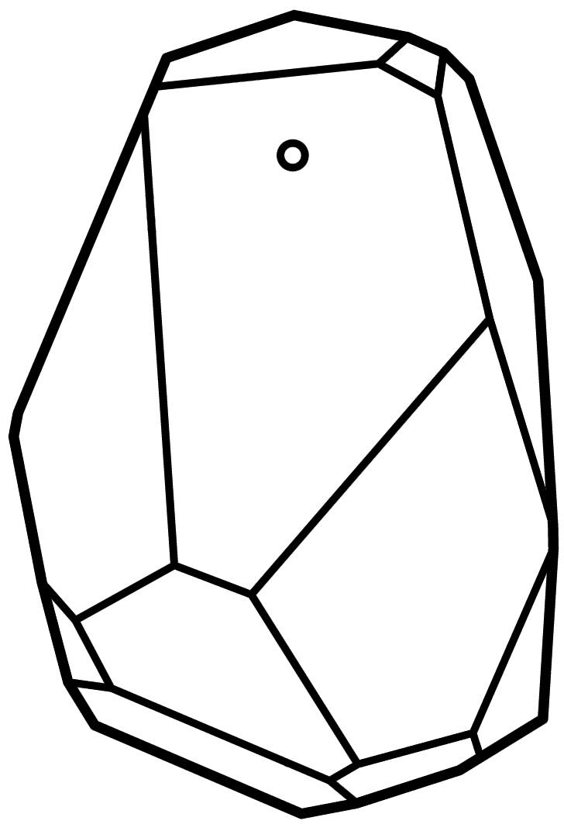


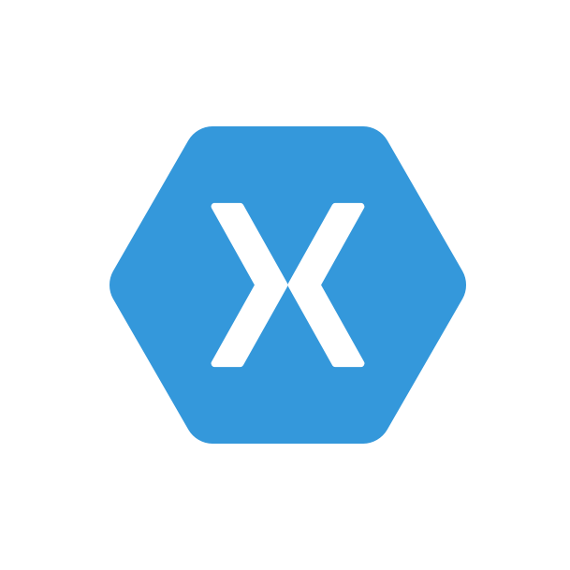
Demo project overview
UWP app
Azure SB Lite
People
Dashboards and Visualizations
Azure
Stream Analytics
Power BI
Azure
Event Hub
Business Scenarios
Recommendations,
customer churn,
forecasting, etc.
Automated Systems
Com.Xamtastic.Patterns.Azure.EventHub
Xamarin app

Slide 33
No Event Hub support for UWP? No problem
[COMMUNITY] Azure SB Lite .
Access to Microsoft Azure Service Bus from different platforms using AMQP protocol
https://github.com/ppatierno/azuresblite

Slide 34
Demo time Connecting to the cloud

Slide 35
Bonus track: Xamarin components

Slide 36
Estimote SDK
Component ready to use
https://components.xamarin.com/gettingstarted/estimotesdkios
public void ScanForBeacons ()
{
BeaconManager beaconManager;
BeaconRegion region;
beaconManager = new BeaconManager ();
beaconManager.ReturnAllRangedBeaconsAtOnce = true;
var uuid = new NSUuid (“Common-UUID-to-monitor");
region = new BeaconRegion (uuid, "BeaconSample");
beaconManager.StartRangingBeaconsInRegion(region);
beaconManager.RangedBeacons += (sender, e) => {
new UIAlertView("Beacons Found", "Just found: "
+ e.Beacons.Length + " beacons.",
null, "OK").Show();
};
}

Slide 37
[COMMUNITY] Com.Xamtastic.Patterns.Azure.EventHub
Another community library to help us sending messages to Azure EventHub using HTTP protocol
https://www.nuget.org/packages/Com.Xamtastic.Patterns.Azure.EventHub/
[!!] Requires SharedAccessSignature generation

Slide 38
Demo time Take a look at the Xamarin code

Slide 39
Wrapping up…

Slide 40
Lessons learned
NSLocationAlwaysUsageDescription and/or
NSLocationWhenInUseUsageDescription really can ruin your weekend…
Cloud is always on the picture
Don’t re-invent the wheel!

Slide 41
Nothing but <3 for .NET Community

Slide 43
Useful links…
UWP Bluetooth advertising sample
https://github.com/Microsoft/Windows-universal-samples/tree/master/Samples/BluetoothAdvertisement
Company identifiers
https://www.bluetooth.com/specifications/assigned-numbers/company-Identifiers
Eddystone protocol reference
https://github.com/google/eddystone
iBeacon protocol reference
https:// developer.apple.com/ibeacon/Getting-Started-with-iBeacon.pdf

Slide 44
…and demo code is already uploaded
http://github.com/gk-8/beacon-insights
keep in mind it’s for demo purposes ☺

Slide 45
http://aka.ms/DOTNETT3S4

Slide 46
Gorka Madariaga
Technical Evangelist, .NET developer
@Gk_8
http://aka.ms/DOTNETT3S4

